Slide 1
And Miles To Go Before We Sleep: The Struggle To Rescue The Records of Hilldale Cemetery, Danville, KY
Highlighting the work of the Central Kentucky African American Cemetery Association, 2019-2020

Slide 2
Dennis and Diadama (Taylor) Doram
The gravestones of Dennis and Diadama (Taylor) Doram are among the oldest in Hilldale Cemetery (1869 and 1883).
Due to poor record-keeping, however, unless one knew where they were buried, one had to search through 2/3 of the 7.5 acre cemetery to find them.

Slide 3
History and Description of Hilldale
The Town of Danville purchased three acres on Duncan Hill Road (then outside town limits) from John and Serra Bell Cowan in 1868.
The first known burial was Dennis Doram (Section D Row 11 Grave 2) in 1869.
Some stones have older dates, but these have probably been moved here from older cemeteries.
The Cemetery now consists of 7.5 acres.

Slide 4
Hilldale Cemetery, Layout
Sections A, B, C, D, E, and County (X on the spreadsheets), Hilldale Cemetery
Sections A, B, C, D, E, and County, Hilldale Cemetery

Slide 5
The Goals
This is the FIRST TIME that Sections B, C, D, E, and the County have ever been mapped.
Up to now, only Section A (the new section) had any sort of accurate records.
If one’s relative were buried in Section B, C, D, E or “County” (75% of the 7.5 acre cemetery) there was no indication as to the actual location, requiring one to physically search the entire cemetery for a stone may or may not be extant.

Slide 6
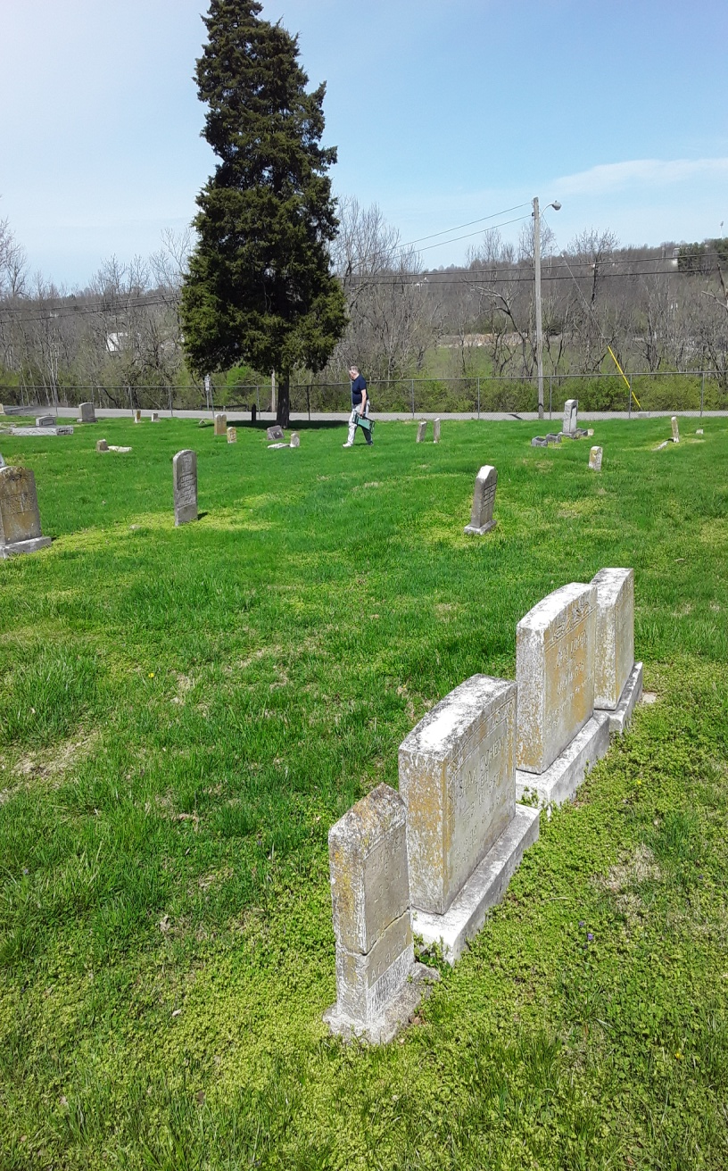
The Goals
Our project is to physically locate, by Section, Row, and Grave, all readable graves, as well as fieldstones and now unreadable markers.
These are not all who are buried here, but we feel that at least locating the identifiable graves, we are providing a service to those buried here, and their families.

Slide 7
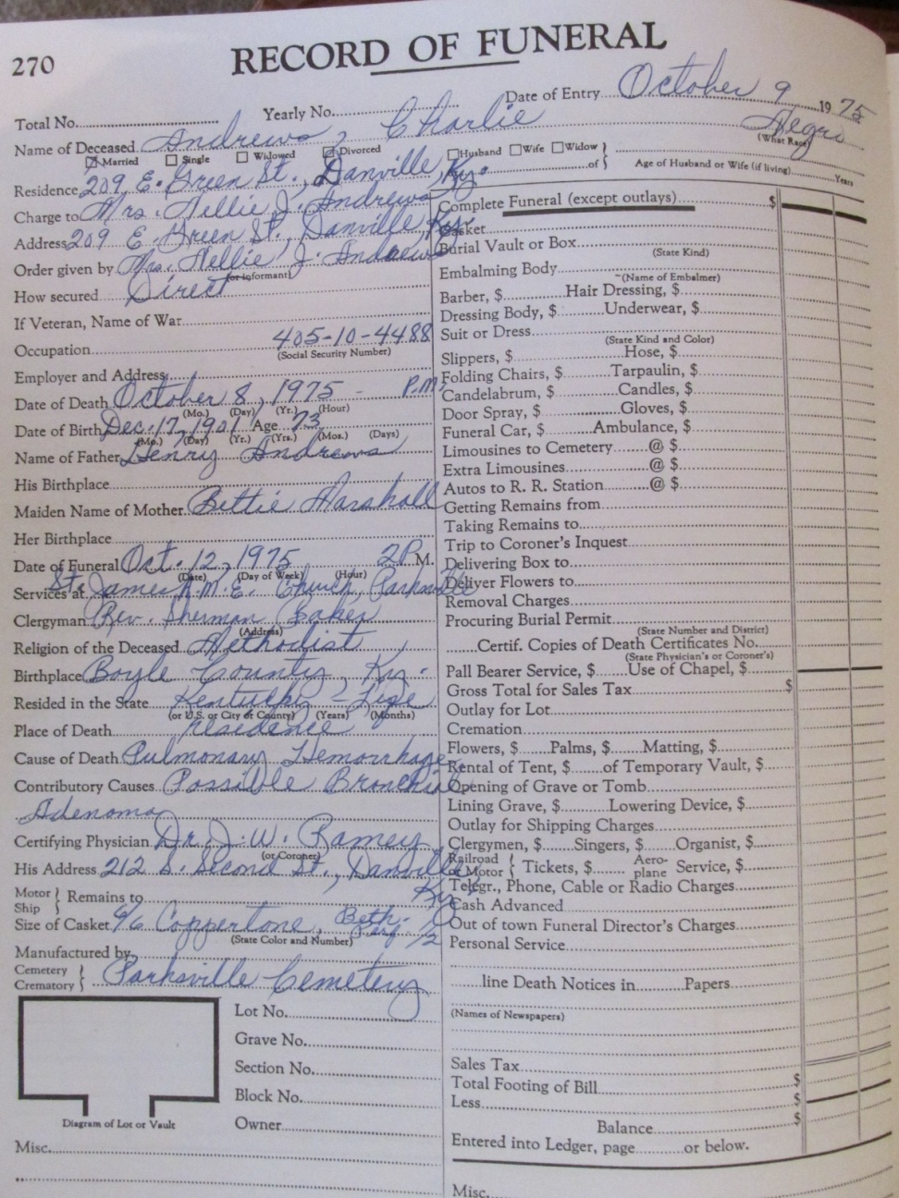
History of Records
In the past, some records were kept at local funeral homes (Rt).
Some were kept by various sextons.
Some were kept by the city beginning about 1962.
There are reports of a fire at a funeral home, but those reports are not confirmed.

Slide 8
Issues with records - Incomplete
We have recorded 1757 gravestones with 2246 names.
Find A Grave has photos of 560 stones.
City records show 1585 names.
Below is what city records look like for part of 1971. The “Division” is no longer used.
Robert Fitzgerald is supposedly in Section C Lot 46 Grave 46. He is in fact in the “County” section.
We have NO idea where the “Baby lot” is.

Slide 9
Issues with records - Incomplete
270 obituaries show Hilldale; more show Boyle Co, Danville, or even Hillcrest.
1210 death certificates say Hilldale.
510 funeral programs show Hilldale.
1396 that we KNOW are here but have no stones.
Example – the city’s Robinson family records show only 5 of 17 burials.

Slide 10
Issues with records - Inaccurate
Names are often wrong, sometimes so wrong it is only possible to match records by dates.
Whether they were recorded wrong, or there was an error in transcribing the online records is unknown.
Dates are often off; a man was buried 3 days before he died; another who died in 1988 is not scheduled to be buried until 2028
Many burials in late 60s and early 70s simply listed en masse as "1971“.
Except for Section "A", many listings showing sections are inaccurate, and refer to sections that do not exist.

Slide 11
Issues with records - Inaccurate
Sections are A, B, C, D, E, and County. Records show A, B, C, F, G, I, J, K, L, M, O, P, R, SA, SB, SH, County, Baby, Old, 1, 4, and 7.
When records were put online, they were alphabetized.
However, "Notes" were often on a separate line, so they all sorted together at the beginning of the file, separating them from the names with which they were associated.
Records have not been updated online since 2009.

Slide 12
Making Amends
Records and maps of Bellevue were updated and corrected by a BCGHS member several years ago.
When he went to share them with the city, the person in the city clerk's office wasn't interested.
Consequently, city records remain inaccurate for the main "white" cemetery in the county.
Others tried to update city records, were turned down.

Slide 13
Making Amends
The CKAACA met with city engineer in December 2019 and volunteered to correct and update records.
We have combed Find A Grave, city records, death certificates, obituaries, funeral programs for references.
We have recorded EVERY SINGLE EXTANT STONE in all 7.5 acres, along with birth, death, and interment dates.

Slide 14
Making Amends
Rows in each of the five sections have been numbered, and the graves in each of the rows, to include fieldstones and illegible stones.
Eva Franklin, born 1905, died 1999, was buried in the “Old” section, no lot given, according to city records.
We have located her grave in Section C, first row, first grave.
Her husband, Robert, born 1899, died 1965, had NO location given in city records.
He is also recorded as C-1-1 now, on the same gravestone.
Neither of these people would have been easily located prior to this work.

Slide 15
Making Amends
We have gathered as much information as we can to supplement the bare-bones records.
We have been working for hours nearly every day since mid-December to update and correct these records.
When done (???), Hilldale's records will be much more accurate and complete.
Finally, we have commitments from the City Clerk to accept the records, and from Public Works to install section and row signs throughout the cemetery.

