Slide 1
There’s a Form for That
DOCUMENTING YOUR COLLECTIONS

Slide 2
What is a museum?
“A public or private nonprofit agency or institution organized on a permanent basis for essentially educational or aesthetic purposes which, utilizing a professional staff, owns or utilizes tangible objects, cares for them, and exhibits them to the public.
Museum Services Act, 20 United States Code,
§ 968(4)
(emphasis added)

Slide 3
What types of records should be kept?
 Evidence of legal ownership or possession of all objects
 Catalog record, also called a worksheet or accession sheet
 Provenance information
 Activity of objects, including loans, exhibitions, conservation, and deaccessions
 Other records specific to a collection or a museum’s routine activities

Slide 4
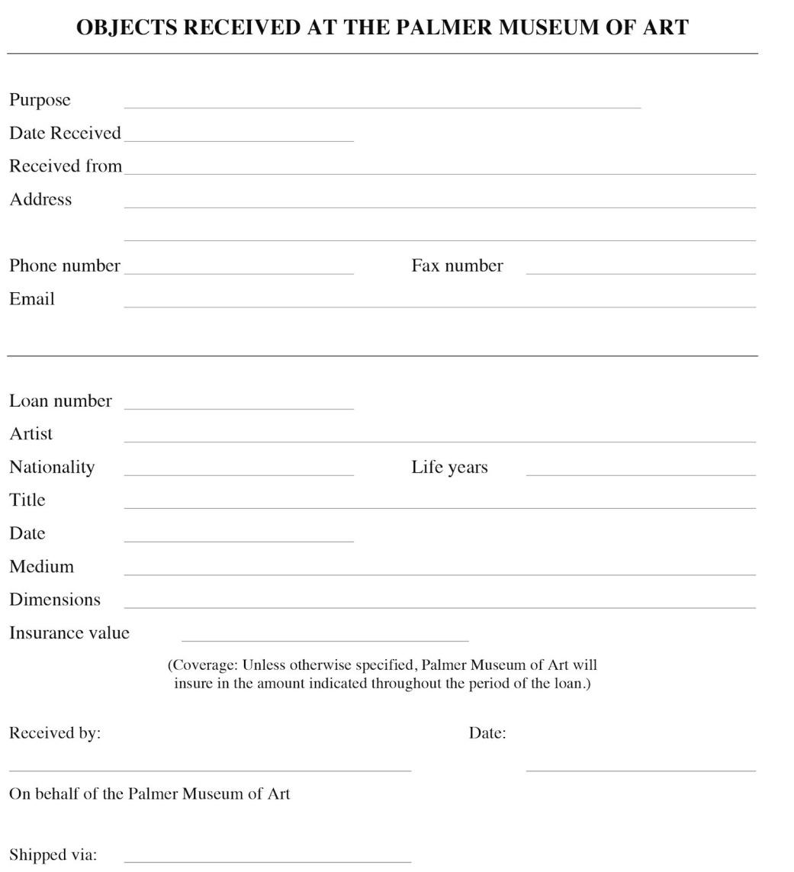
Basic Receipt

Slide 5
Additional information for more complex receipt
In addition to all information on basic receipt:
 Care and handling to be provided
 Packing and transportation arrangements
 Insurance
 Reproduction and credits
 Ownership and changes in ownership
 Custody period, extensions, and right to return

Slide 6
Elements of the receipt
 Name of the object’s owner, the person leaving the object
 Full contact information, address, telephone number, email address
 Reason the object has been left at the museum
 Date the object has been left at the museum
 Description of the object
 Conditions under which the museum accepted the object

Slide 7
Accessioning Documentation
Methods of acquiring objects
 Gift
 Purchase
 Bequest
 Field collection
 Transfer from another institution

Slide 8
Accessioning Documentation: Gifts
Ideal – Deed of Gift
 Name of donor with full contact information
 Name of museum with full contact information
 Description of materials offered
 Statement that the donor owns the objects and has the authority to pass clear title
 Statement that the gift is without restrictions, or specific restrictions
 Statement that the donor relinquishes all rights he/she may have had
 Signature of donor with date signed
 Signature of museum representative with date signed
 Optional: credit line to be used

Slide 9
Accessioning Documentation: Purchases and Bequests
Purchases
 Proof of purchase such as a receipt, bill of sale, etc.
Bequests
 Copy of the relevant pages of the will, including the name of the person representing the estate such as the executor/trix, administrator/trix, and/ or the attorney assisting with the estate.
 Receipt and release forms are used by many probate courts to verify distribution of the bequest; this form should contain a signature of the museum official authorized to accept gifts and bequests for the museum and the date the material was received.

Slide 10
Catalog Documentation
Catalog sheet/worksheet/accession sheet
 Use it to gather as much information as possible
 Include both accession information and catalog information
 Make it specific to your institution, but be sure to gather standard information

Slide 11
Loan Agreements
Elements of an incoming loan agreement
 Borrower, with full contact information; if printed on letterhead, this information will already be on the form
 Lender, with full contact information
 Purpose of loan
 Dates of loan, should include time for shipment to and from the borrower
 Description of the materials to be borrowed
 Statement defining who will insure and insurance value
 Photography permission
 Conditions of the loan
 Authorized signatures and dates signed for both parties

Slide 12
Catalog Documentation
Accession information:
 Maker/artist
 How
 Condition
 Accession number and any other numbers associated with the work
 Value
 Copyright information and Provenance

Slide 13
Loan Agreements
Conditions of the loan
 Care and handling requirements
 Insurance
 Environmental conditions to be maintained
 Permission to clean or conserve
 Statement regarding the borrower’s right to return the object
 Packing and shipping

Slide 14
Deaccessioning
No specific form is required by law. However, the museum must be able to demonstrate that:
 It is aware of the issues to be considered.
 It has developed a process for determining if an object should be deaccessioned.
 It has followed that procedure.
Developing a form to make sure all steps are followed is the easiest way to document that procedure has been followed.

Slide 15
Deaccessioning
Elements to include on a deaccessioning form
 Description of the material to be deaccessioned
 Statement that the museum has title to the material and, if it was a gift, that there are no restrictions on the gift or what the restrictions are
 The museum’s acceptable reasons for deaccessioning and which ones apply in the specific instance
 What outside opinions have been solicited and what they said
 Who on staff is making the recommendation to remove the object from the collection and on what date it was made
 If object was a gift, what the policy is for notifying donors and when and by whom the policy was followed
 Name and signature of person authorized to remove the object
 The date on which the deaccession was approved
Since this form is for internal use and is not a contract with any other entity, it does not need to be vetted by legal counsel.

Slide 16
Other Records
 Current location records
 Master log
 Copyright information and/or licenses
 Condition reports
 Correspondence
 Photographs
 Appraisals or other valuation documents
 Insurance documents if there has been an insurance claim
 Loss and damage records

Slide 17
Final Thoughts
Characteristics of bad documentation:
 Loss of context caused by incomplete documentation
 Reliance on institutional memory instead of written records
 Inconsistency within records
 Bad handwriting

Slide 18
Final Thoughts
Characteristics of good documentation:
 Records are dated
 Complete in all aspects
 Easily understood, uses standard terminology, is clear and precise
 Includes good descriptions and photographs
 Includes the history of the records, when new information is added and by whom
 Legible handwriting

Slide 19
Final Final Thoughts
 In general, be clear, be permanent, be legible, and be as comprehensive as possible.
 Start today to make clear and clean records
 Create a clear documentation policy and train everyone who uses it
 Create a schedule to clean up old records, and create a history as you go
 Be kind to your future self – what would you want to be able to find in 100 years?

Slide 20
This PowerPoint is heavily modified version of one written by
Beverly Balger Sutley
Registrar, Palmer Museum of Art
The Pennsylvania State University
University Park, PA 16802
814-863-9189
bxb35@psu.edu

